Slide 1
TRELLIS PLOTS

Slide 2

What is Trellis ?
A grid framework containing square or rectangular plots to help climbers and creepers grow.

Slide 3
What is Trellis Plot ?
It’s repetition of similar charts across a grid.
It’s based on the idea of conditioning on the values taken on by one or more variables in the dataset

Slide 4
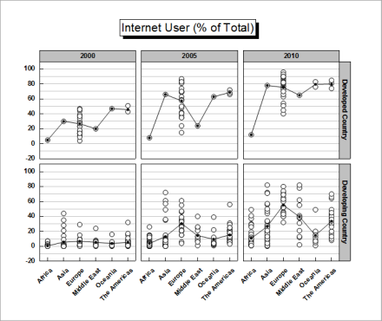

Slide 5
What is Trellis Plot ?
Each panel in the trellis plot is the visualization of a subset of the original data and these subsets are defined by the categories in the column.
This is best suitable for categorical variables.

Slide 6
What happens if there continuous variables ?
If there are continuous variables we shingle them into overlapping intervals.

Slide 7
Note :-
Maximum of 8 variables can be combined.
To optimize the display order the variables.
Every variable except for the axis variables should be categorical if not do shingling.
The indexing is read from left to right and bottom to top.
Takes all possible combinations of the categories of the variables chosen.

Slide 8
Advantages :-
Quick identification of similarities and disadvantages between different categories.
Gives visualization of all possible combinations of the categories.
Various charts can be visualized inside the panels.
Eg :- Scatter Plots, Box Plots, Histogram.
Same scaling is provided for all panels for easier comparison.

Slide 9
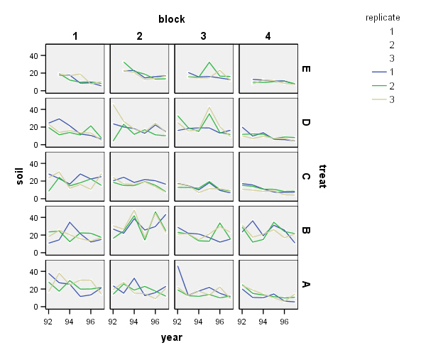
Panel : Line Graph

Slide 10
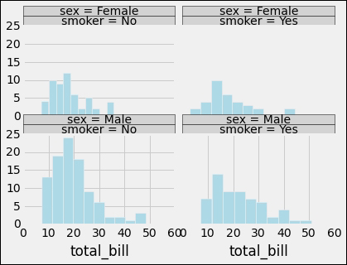
Panel : Histogram

Slide 11
Disadvantages :-
Too many categories in each variable would create many panels which would be hard to visualize.
In shingling we do not know how much observations have gone to make each panel which is harder in the case of box plots.
Overlapping intervals in case of shingling.

Slide 12
Applications :-
In any situation where we need to compare many categories.

Slide 13
Tools :-
R
Excel
SPSS
Python

Slide 14
References :-
https://www.stat.auckland.ac.nz/~ihaka/787/lectures-trellis.pdf
https://www.forbes.com/sites/naomirobbins/2012/06/07/trellis-plot-alternative-to-three-dimensional-bar-charts/
https://onlinelibrary.wiley.com/doi/full/10.1002/9781118445112.stat00453.pub2

Slide 15
Thank You

